Slide 1
Mental fortitude to enhance sporting performance
Personal Development
Business and Leadership

Slide 2
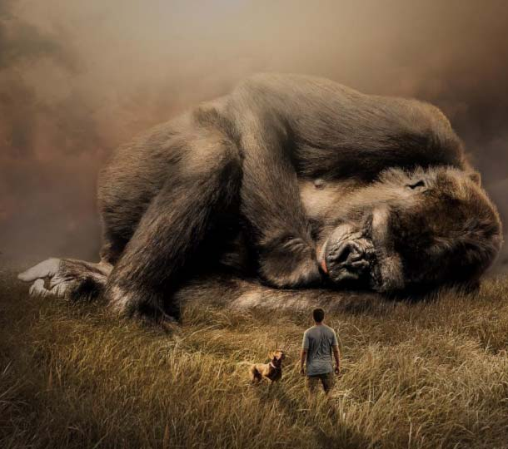
BE THE CHANGE you want to see IN THE WORLD.
3 key problem areas identified
LOYALTY
TRUST
EXPECTATION
Two Black Bags
Mahatma Gandhi – Civil Rights Activist

Slide 3
Write what should NOT be forgotten.
Who are we?
What are our expectations?
How can we improve?
Isabel Allende – Chilean Author

Slide 4
Sometimes dreams .
are wiser than waking.
Identify
Assess
Remedy
Results
Black Elk – Oglala Sioux Medicine Man

Slide 5
Surely something resides in this heart that is not perishable and life is more than a dream.
Endorse and embed
Mary Wollstonecraft – British Philosopher & Feminist

Slide 6
THE LEGACY
The 3 R’s
The TICKET

Slide 7
If you are always trying to be normal, you will never know how AMAZING you can be.
Maya Angelou – American Poet

Slide 8
“The mosaic of life is created from a pattern of shattered expectation. The picture we create is built from piecing together the hopes and dreams we have saved from the burning embers of perceived disappointment and failure.”
Ivor Bourne -Transition Strategist
Notes:
1- Insert picture >> Format >> Send to back
2- Add quote >> Add Author/Writer >> Adjust text to suit image

